Slide 1

RECCE
SOUTH CITY MALL, KOLKATA

Slide 2
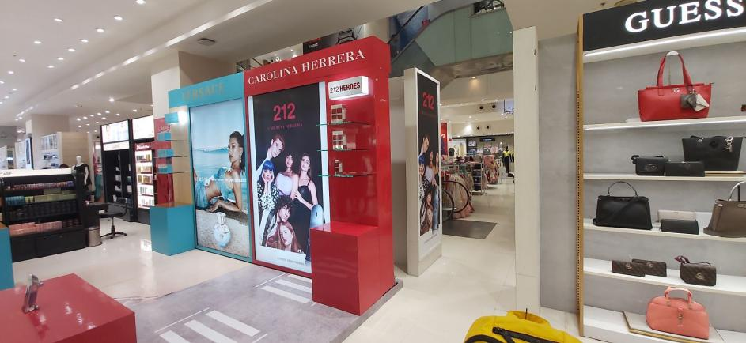
33 X 95 Vinyl
28GFSOH3

Slide 3
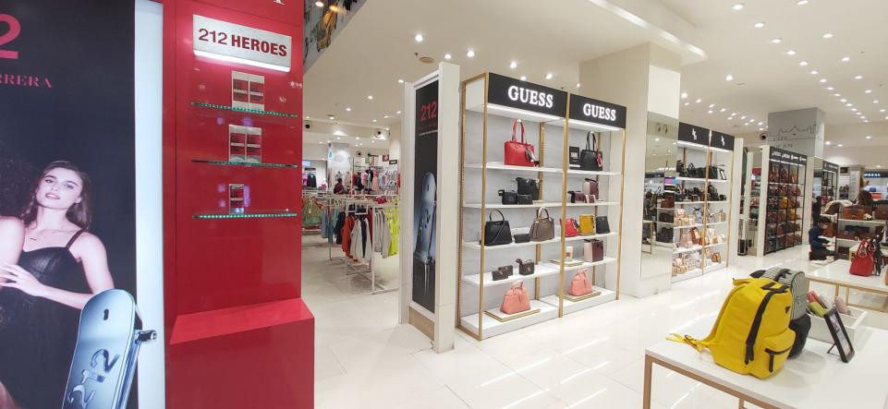
25.5 X 95 Vinyl
28GFSOH4

Slide 4
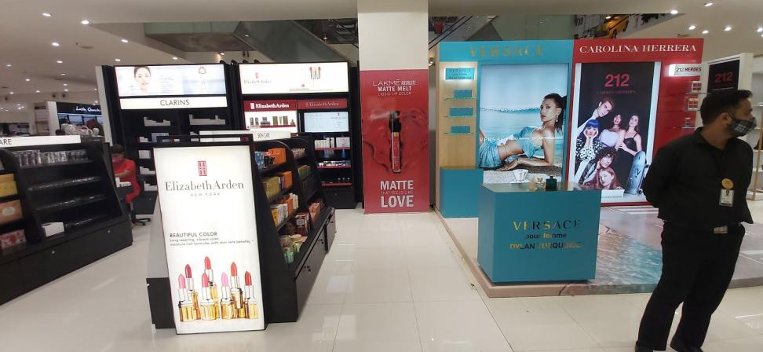
45 X 96 Vinyl+Sunboard
28GFSOH5

Slide 5
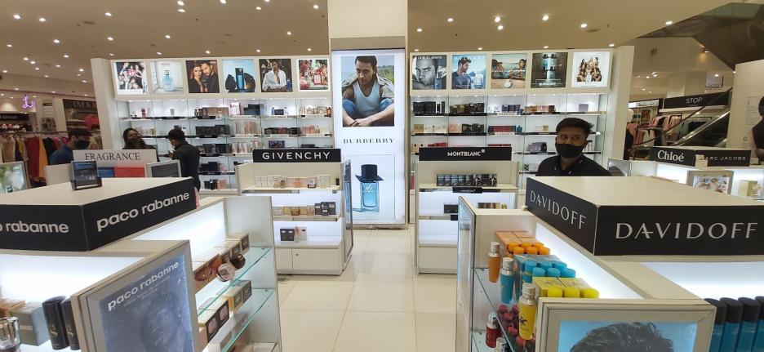
41.75 X 102 BL Fabric
28GFSOH5b

Slide 6
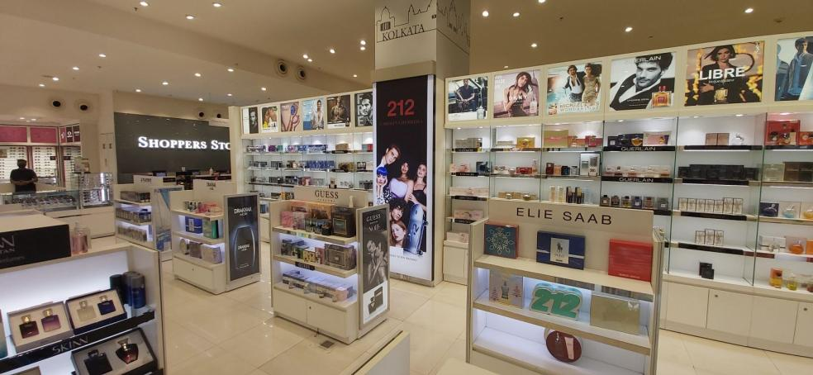
36.75 X 102 BL Fabric
28GFSOH5c

Slide 7
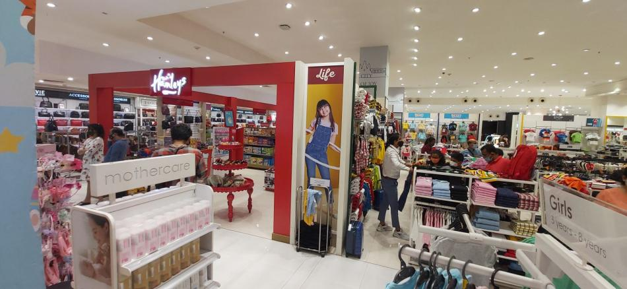
23 X 96 Vinyl
28GFSOH13

Slide 8
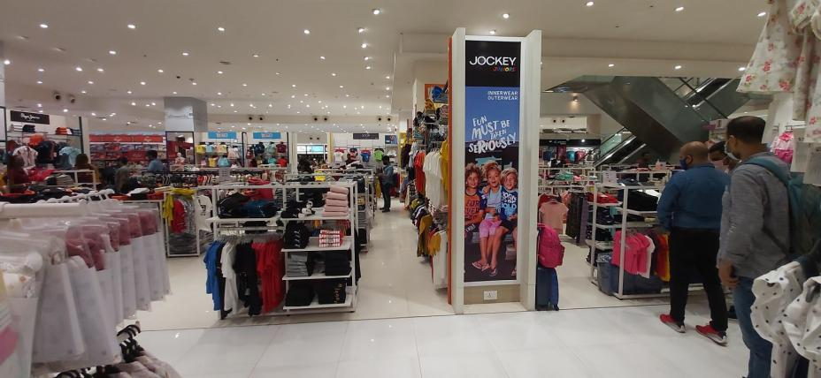
23 X 96 Vinyl
28GFSOH14

Slide 9
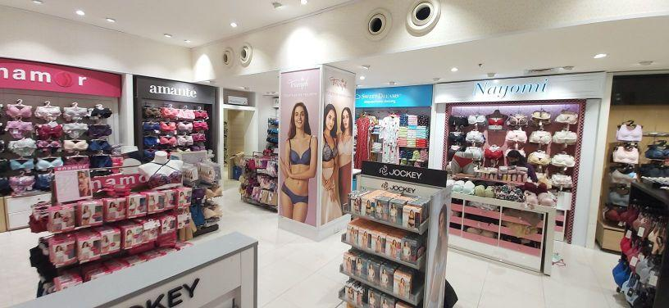
35 X 101 Vinyl --- 2 Pcs
28GFSOH19

Slide 10
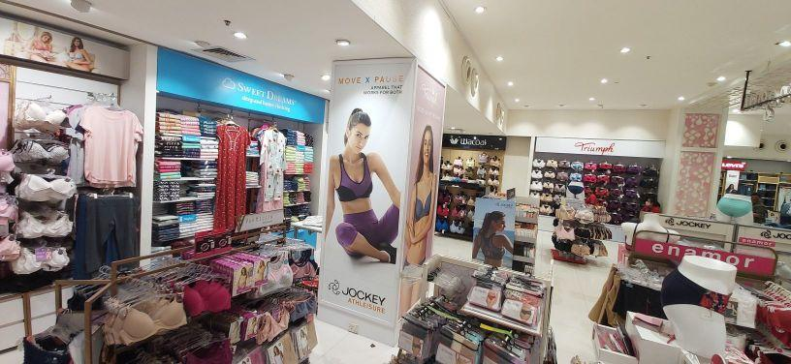
35 X 101 Vinyl
28GFSOH20

Slide 11
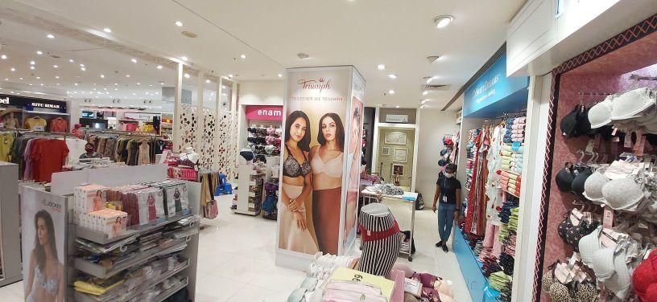
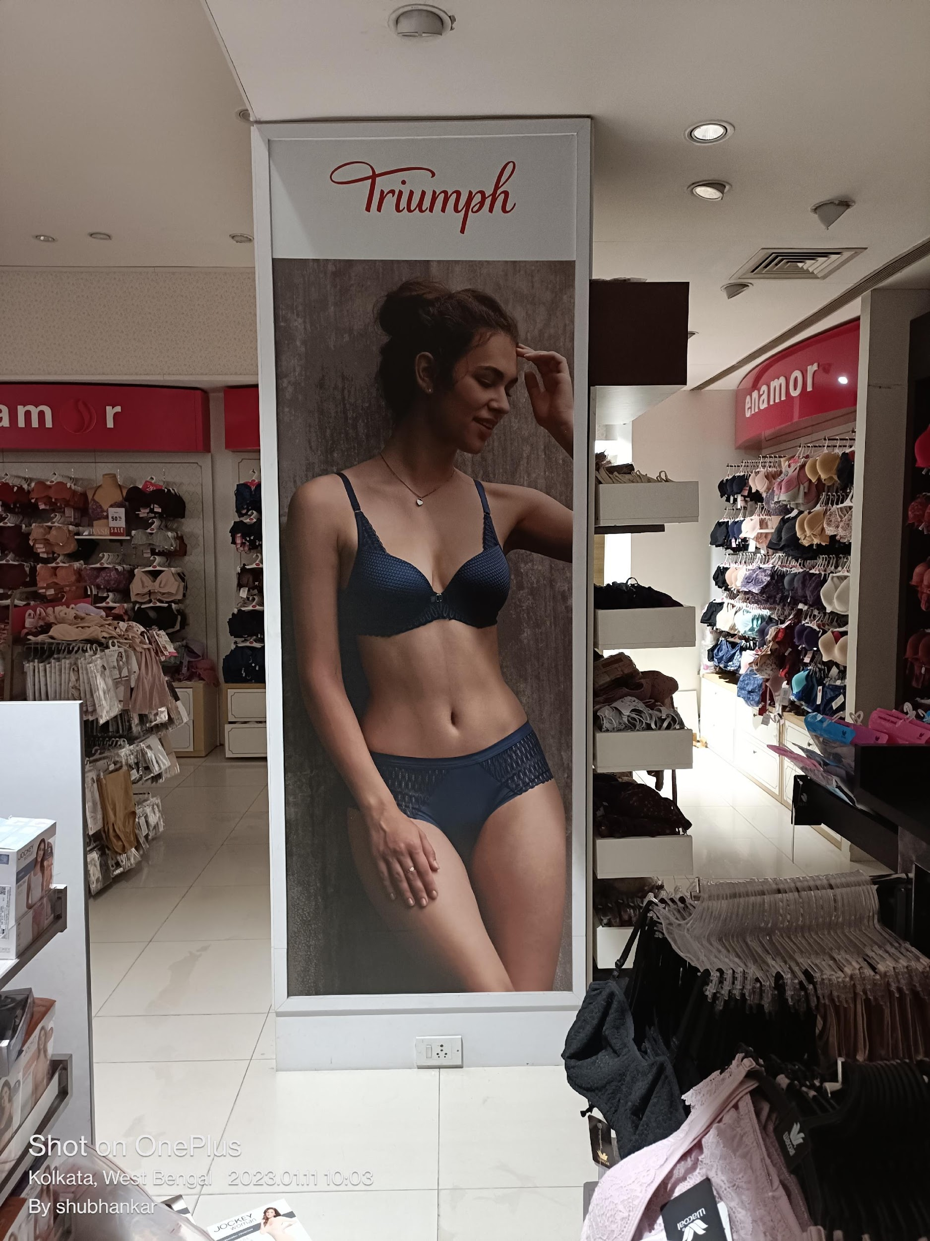
Not Available, Photo attatched
28GFSOH21

Slide 12
35 X 101 Vinyl
28GFSOH22

Slide 13
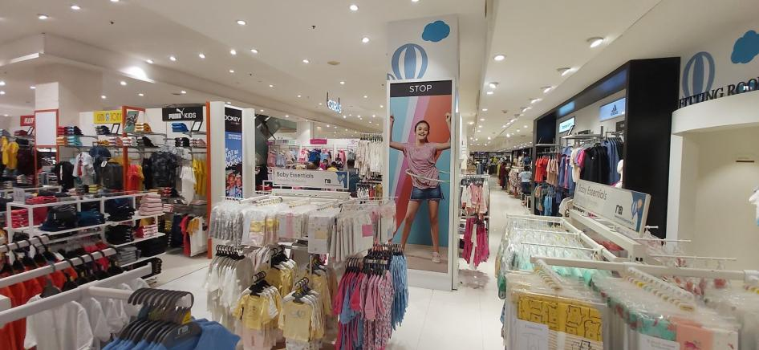
34 X 102 Vinyl
28GFSOH23

Slide 14
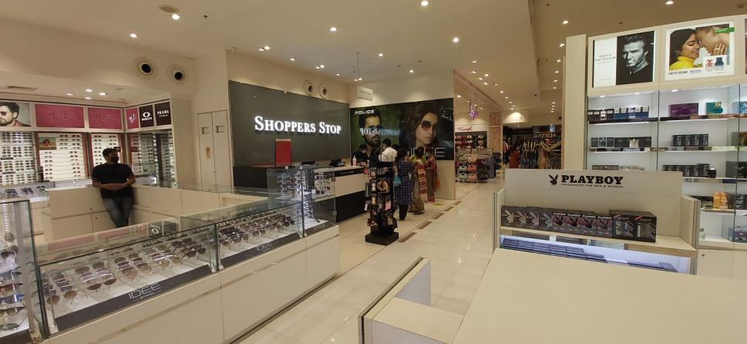
142 X 68 Vinyl
28GFCP1

Slide 15
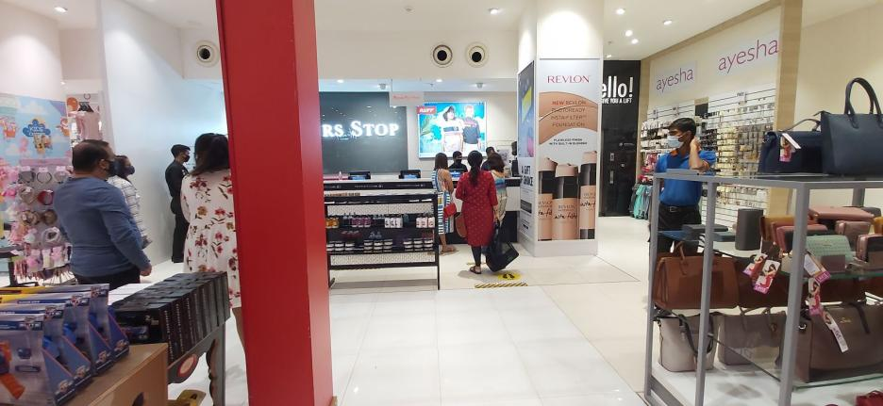
A - 60 X 48 BL Fabric
B - 34 X 102 Vinyl
28GFCP2
B
A

Slide 16
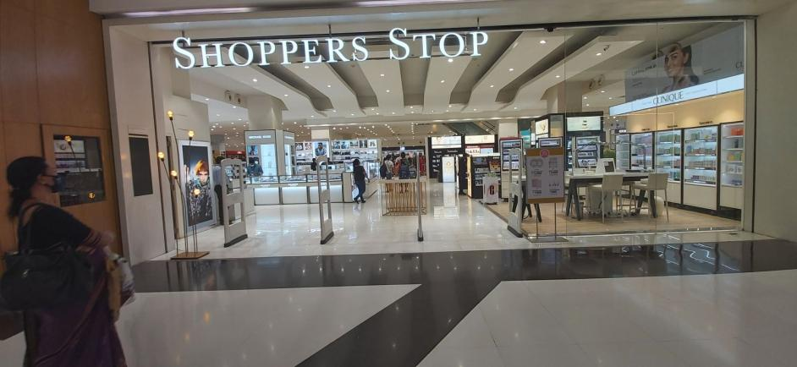
Sensomatic – 16 X 58 – 4 Pcs
28GFSV1

Slide 17
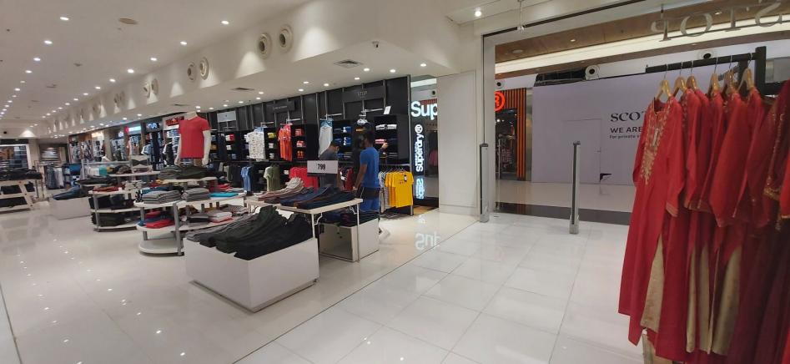
30.5 X 101 Vinyl
28FFSOH1

Slide 18
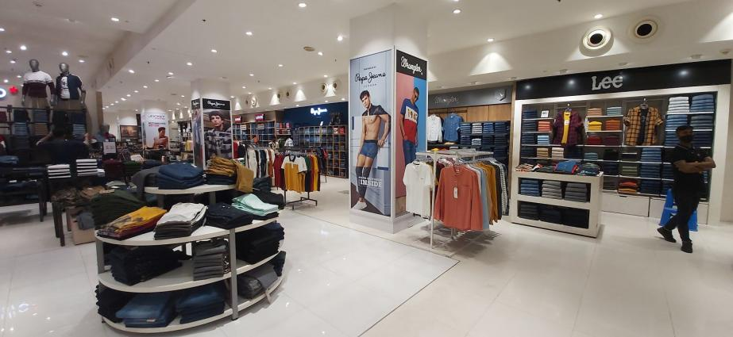
36 X 102 Vinyl --- 2 Pcs
28FFSOH4
A
B

Slide 19
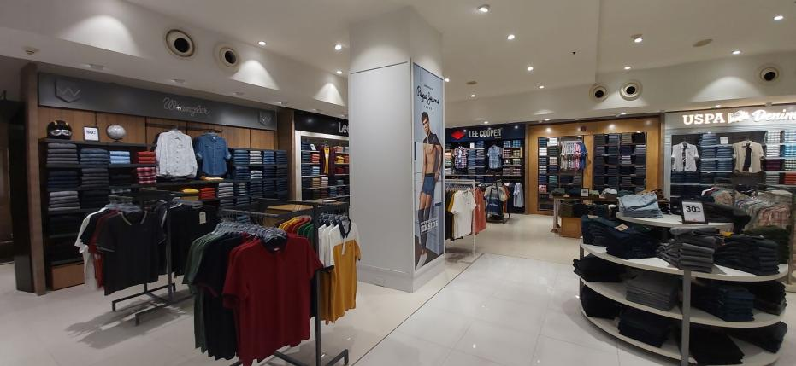
36 X 102 Vinyl
28FFSOH4b

Slide 20
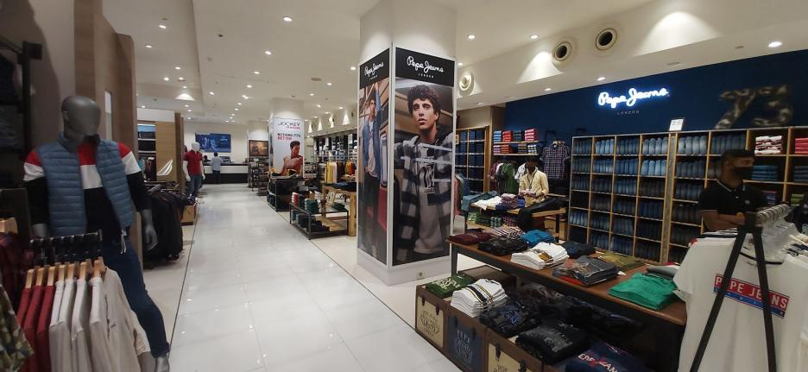
36 X 102 Vinyl --- 2 Pcs
28FFSOH5

Slide 21
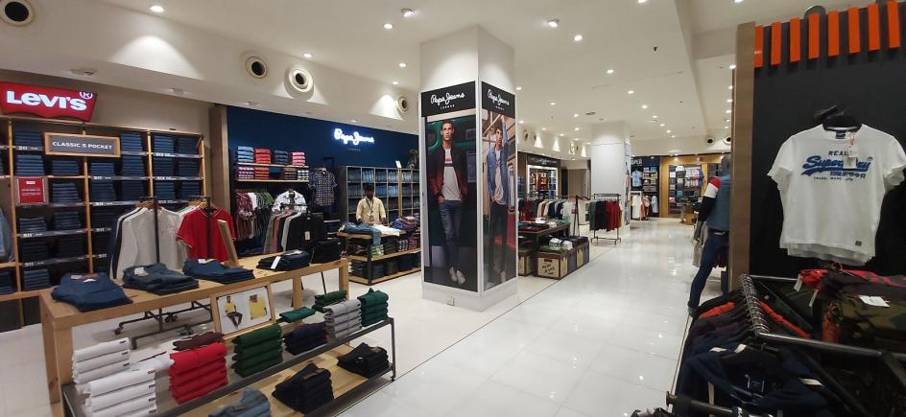
36 X 102 Vinyl
28FFSOH5a

Slide 22

36 X 102 Vinyl
28FFSOH5b

Slide 23
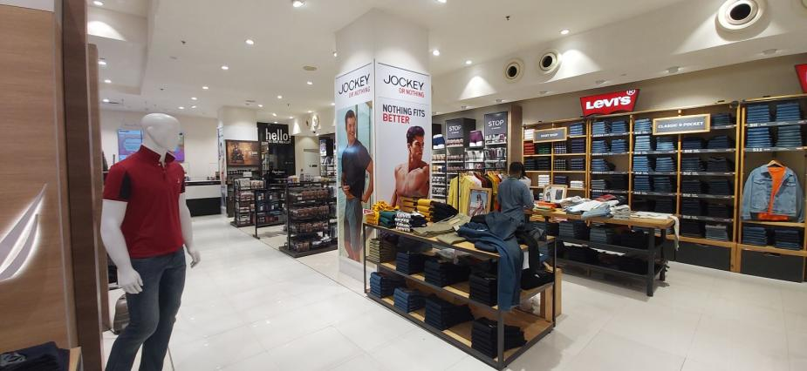
36 X 102 Vinyl --- 2 Pcs
28FFSOH6

Slide 24
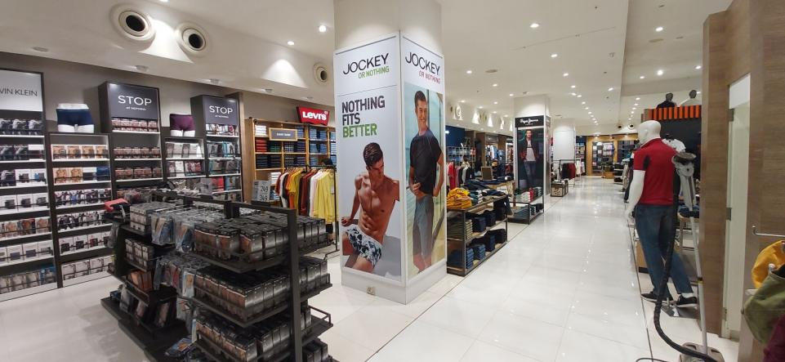
36 X 102 Vinyl
28FFSOH6a

Slide 25

36 X 102 Vinyl
28FFSOH6b

Slide 26
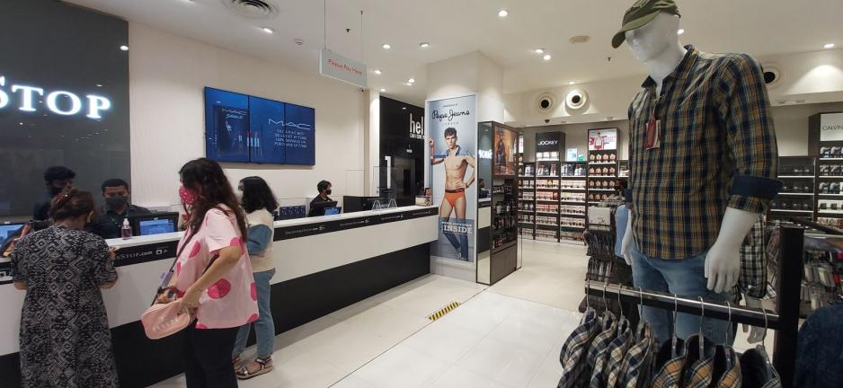
36 X 102 Vinyl
28FFSOH9

Slide 27
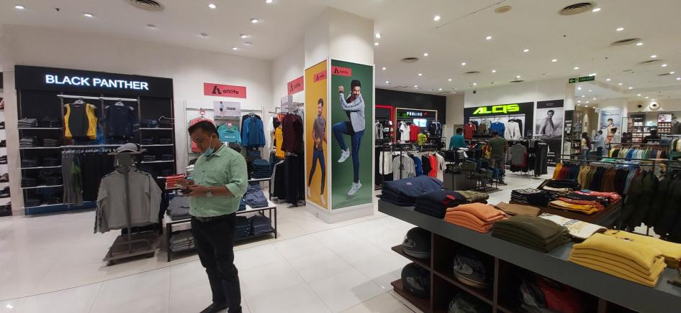
36 X 102 Vinyl
28FFSOH13

Slide 28

36 X 102 Vinyl
28FFSOH13a

Slide 29
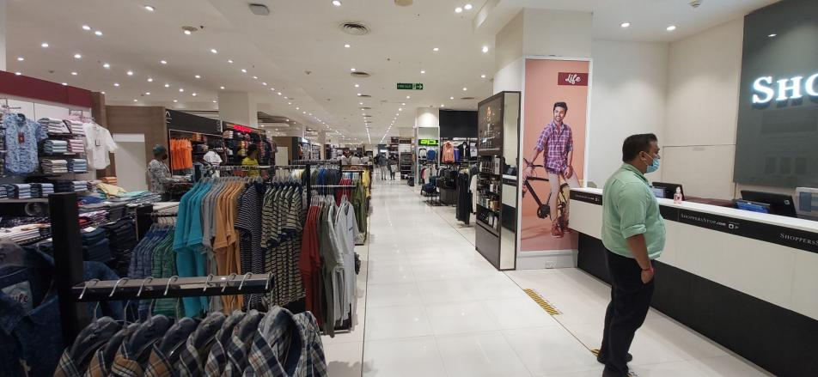
36 X 102 Vinyl
28FFSOH21

Slide 30
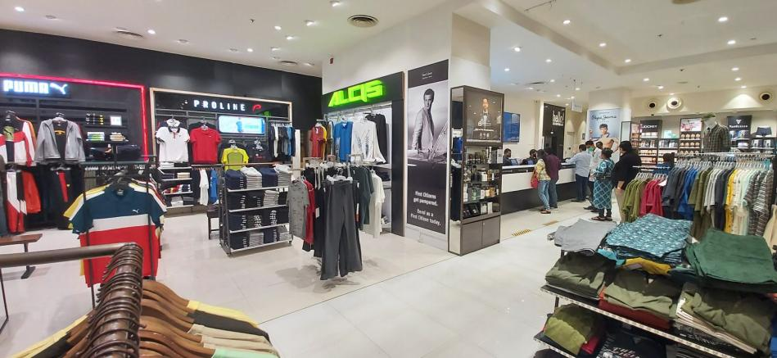
36 X 102 Vinyl
28FFSOH22

Slide 31
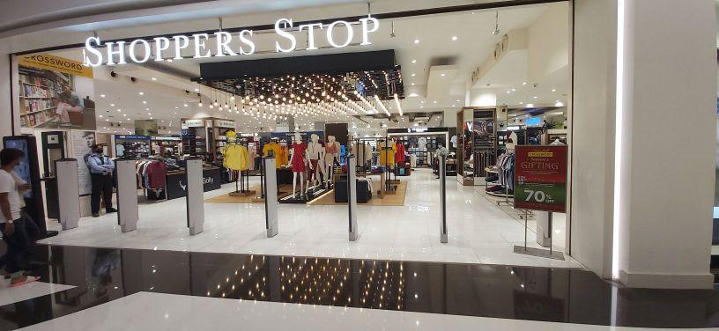
Unable to take measurements due to short time span
28FFSV1

Slide 32
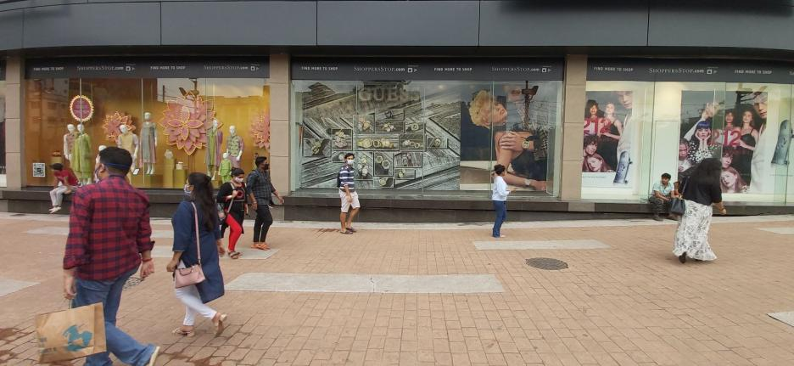
Unable to take measurements due to short time span
28ODW1

Slide 33

Unable to take measurements due to short time span
28ODW2

Slide 34
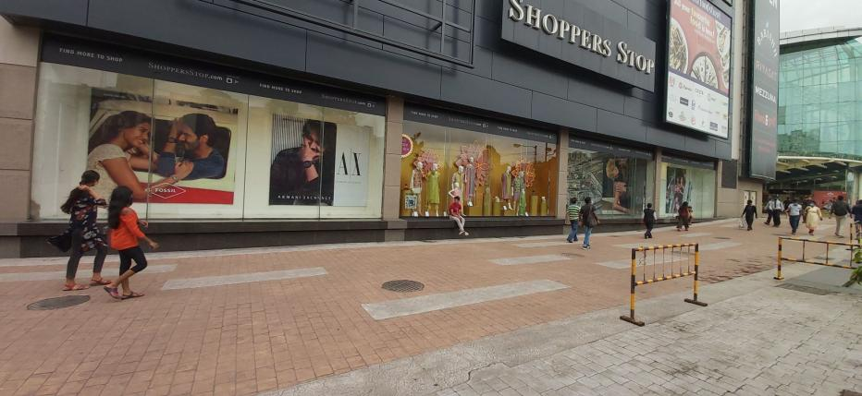
Unable to take measurements due to short time span
28ODW3

Slide 35

Unable to take measurements due to short time span
28ODW4

Slide 36
28ODW5

Slide 37
28ODW6

Slide 38
28ODW7

Slide 39
28ODW8

Slide 40
28ODW9

Slide 41
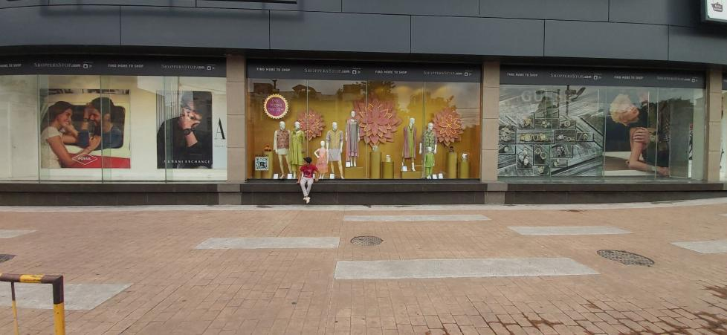
Unable to take measurements due to short time span
28ODW10

Slide 42
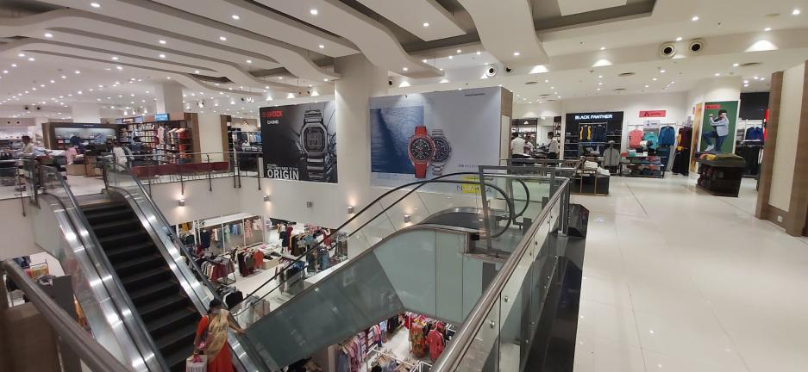
Unable to take measurements due to short time span
28ESC1

Slide 43

Unable to take measurements due to short time span
28ESC2

Slide 44
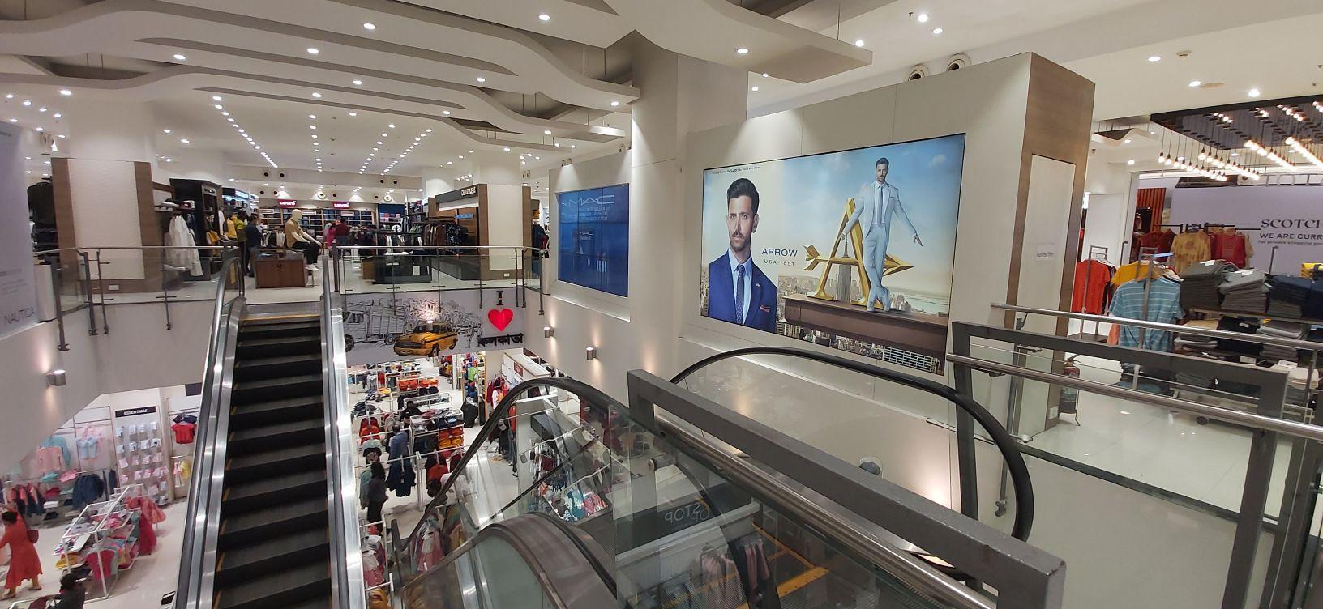
Unable to take measurements due to short time span
Kol 3 | 28ESC3 | 122x70 | Eco Solvent Self adhesive vinyl with matt lamination

Slide 45
LED Screen
28DTH1

Slide 46
THANK YOU

